Slide 1

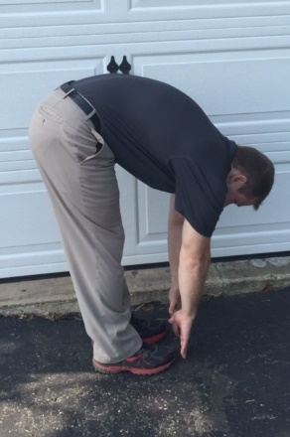




Shoveling: How to Avoid the Pains of Winter
5 Rules To Remember
1. Warm up and stretch before you start
2. Don’t move the snow twice—have a plan
3. Move snow the shortest distance possible
4. Rest frequently
5. Use correct technique
*If heavy/wet snow, make sure to do a half scoop
Correct Shoveling Technique
Knees slightly bent
Back in neutral position
Push snow
Lift with front palm up
Wrists neutral
Shift weight from back to front foot
Try these stretches before, during, and after shoveling to prevent lower back and leg discomfort.
Stretch 1: Bending over to reach toes
will not only stretch your whole back but it will also stretch the back of your legs to help reduce fatigue.
    Avoid twisting: Using the best practices above will maximize the power of your muscles to perform the work and support your joints.
Stretch 2: Keep hips and toes pointed forward with hands on hips. Gently lean back to undo accumulated stress in the mid and lower back. Tip: Pinch elbows back to help reduce tension felt in upper back.

